Slide 1
8086 and Memory Interfacing
Arnab Bhattacharjee
Lecturer, Department of CSE,
United International University
Email id : arnab@cse.uiu.ac.bd
Courtesy: Nasif M. Sir,
Md. Shafqat Talukder Rakin Sir

Slide 2
Memory organization
In the design of all computers, semiconductor memories are used as primary storage for data and code
They are connected directly to the CPU and they are the memory the CPU asks for information (code or data)
Among the most widely used are RAM and ROM
The physical address space, or memory map, of a microprocessor refers to the range of addresses of memory location that can accessed by the microprocessor. The size of the address space depends on the number of address lines of the microprocessor.
At least two memory devices are required in a microprocessor system: one for the ROM and one for the RAM.
Memory Capacity
The number of bits/bytes that a semiconductor memory chip can store is called its chip capacity

Slide 3
Memory organization
A memory device or memory chip must have four types of lines or connections: Address, Data, Enable and Control.
Address Lines:
The input lines that select a memory location within the memory device.
Decoders are used, inside the memory chip, to select a specific location
The number of address pins on a memory chip specifies the number of memory locations.
If ‘n’ specifies the number of address lines, then
Number of memory location = 2^{n}

Slide 4
Memory organization
Data Lines:
The data pins are typically bi-directional in read-write memories.
The number of data pins is related to the size of the memory location .
For example, an 8-bit wide (byte-wide) memory device has 8 data pins
The number of data lines (m-bits) determines the size of each location in the memory.
Memory Capacity = 2^{n} x m
Notes:
Memory storage device capacity/size
Processor capacity/size

Slide 5
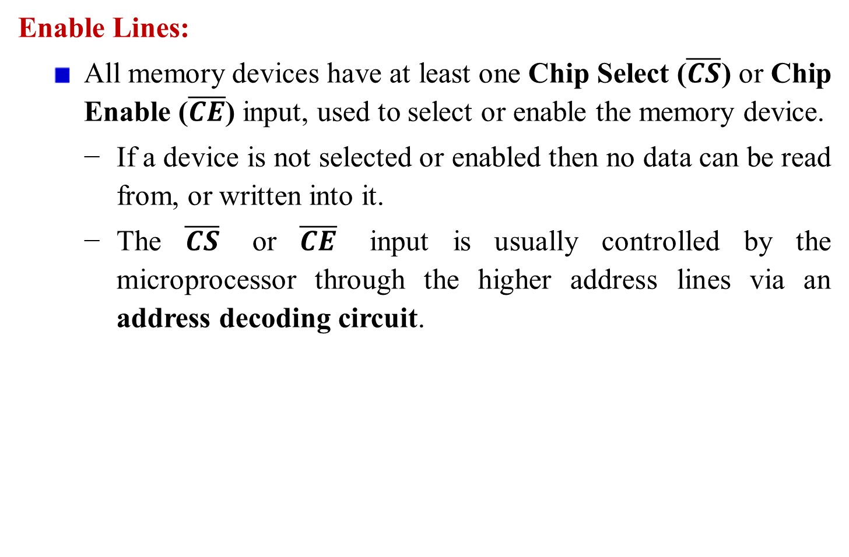
Memory organization
Enable Lines:
All memory devices have at least one Chip Select ($\overline{CS}$) or Chip Enable ($\overline{CE}$) input, used to select or enable the memory device.
If a device is not selected or enabled then no data can be read from, or written into it.
The $\overline{CS}$ or $\overline{CE}$ input is usually controlled by the microprocessor through the higher address lines via an address decoding circuit.

Slide 6
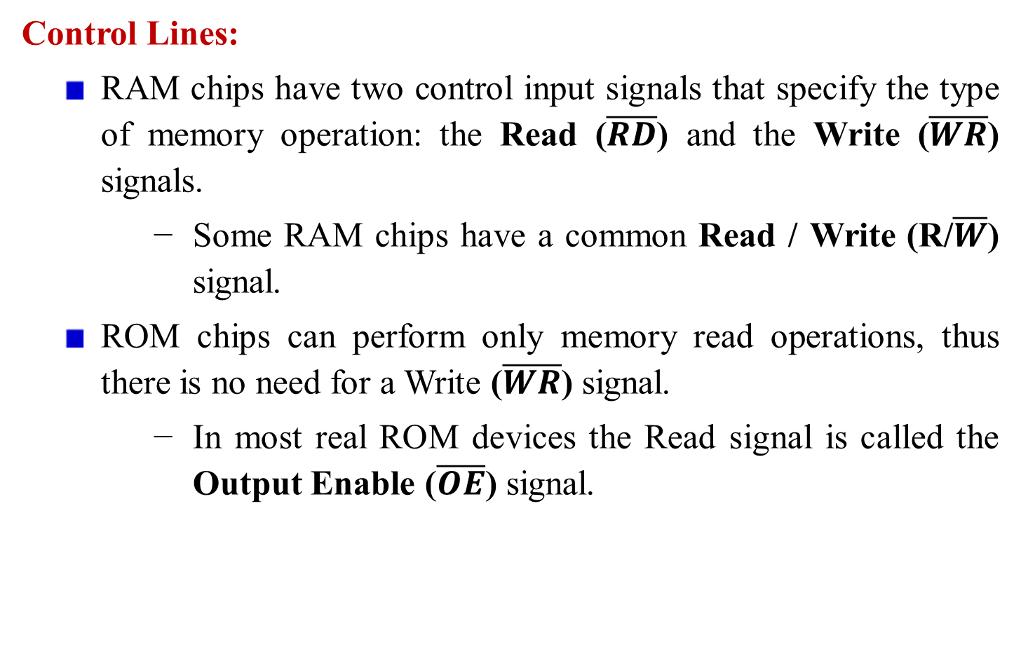
Memory organization
Control Lines:
RAM chips have two control input signals that specify the type of memory operation: the Read ($\overline{RD}$)and the Write ($\overline{WR}$) signals.
Some RAM chips have a common Read /Write (R/$\overline{W}$) signal.
ROM chips can perform only memory read operations, thus there is no need for a Write ($\overline{WR}$) signal.
In most real ROM devices the Read signal is called the Output Enable ($\overline{OE}$) signal.

Slide 7


Memory organization
Chip select
Read/Write
2^{n} words
m-bits per word
$$\overline{CS}$$
R/$\overline{W}$
n-address lines
A₀ - A_{n}
m-data lines
D₀ - D_{m}
RAM Memory Chip

Slide 8


Memory organization
Chip select
Read
2^{n} words
m-bits per word
$$\overline{CS}$$
$$\overline{RD}$$
n-address lines
A₀ - A_{n}
m-data lines
D₀ - D_{m}
ROM Memory Chip

Slide 9
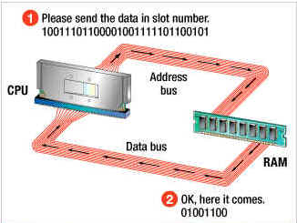

Slide 10
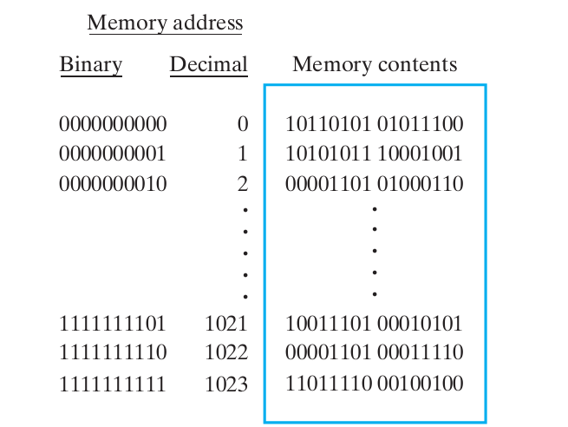
Memory organization

Slide 11
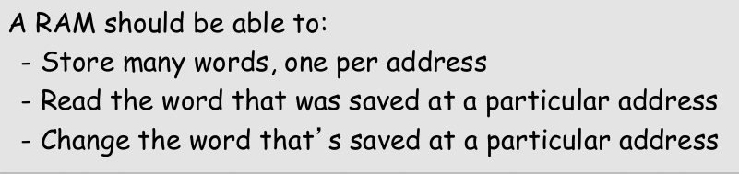
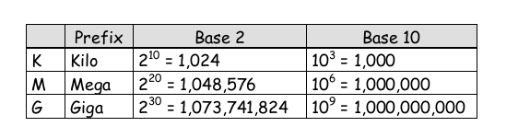
Memory organization

Slide 12
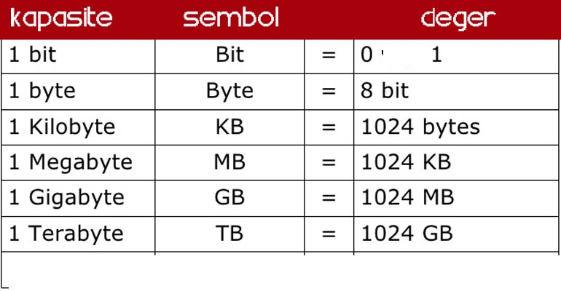
Memory organization
Memory capacity
- The number of bits that a semiconductor memory chip can store is called its memory capacity.

Slide 13
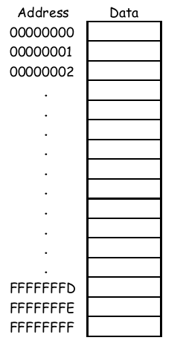


Slide 14
Calculate total addressable memory in a RAM chip when there is a 16-bit data bus and a 32-bit address bus.
Calculate total addressable memory in a ROM chip when there is a 32-bit data bus and a 16-bit address bus.

Slide 15
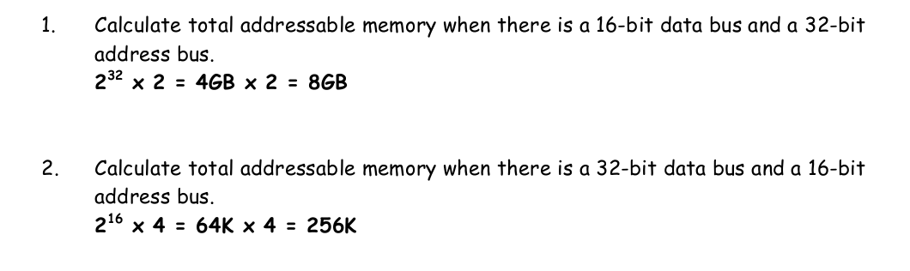

Slide 16
Operation of RAM chip
RAM is also called volatile memory because they will not retain data without power
The main difference between ROM and RAM is that RAM is written under normal operation, whereas ROM is programmed outside the computer and normally is only read.

Slide 17
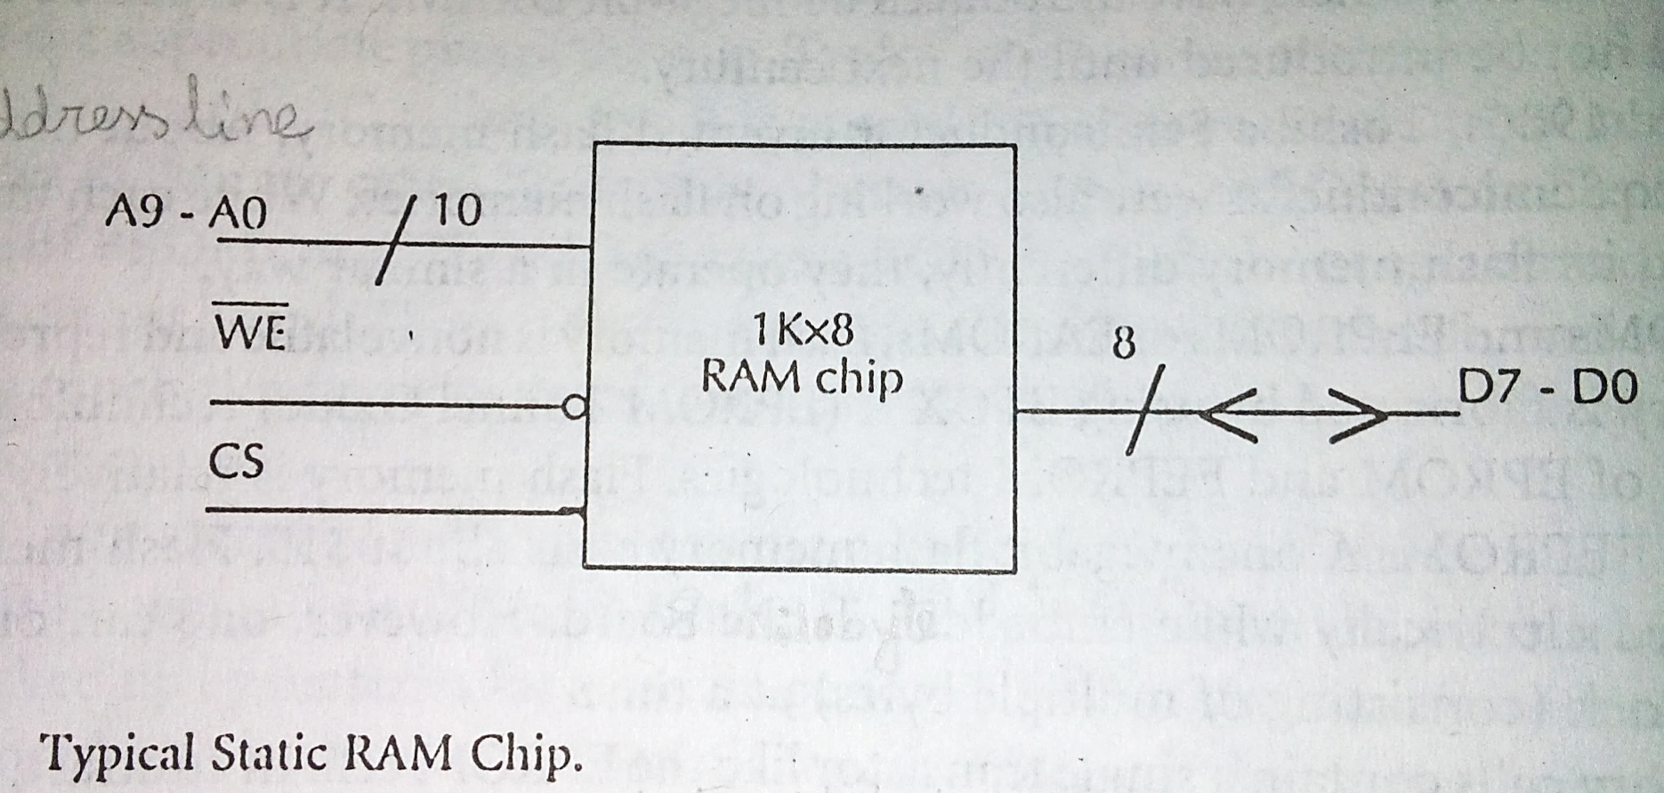
Typical RAM chip

Slide 18
Operation of RAM chip
CS | WE’ | MODE | Status of D7 – D0 | Power
L | X | Not selected | High Impedance (as if it is disconnected) | Standby
H | L | Write | Acts as input bus | Active
H | H | Read | Acts as output bus | Active
a. When CS input is LOW, the chip is not selected. Because, D7-D0 is in high impedance state. The memory chip is disabled and reduces it’s power requirement. This feature reduces around 86% power.
High impedance circuit are low current, high voltage
Notes:
Three-state logic

Slide 19
Operation of RAM chip
CS | WE’ | MODE | Status of D7 – D0 | Power
L | X | Not selected | High Impedance | Standby
H | L | Write | Acts as input bus | Active
H | H | Read | Acts as output bus | Active
b. When CS=HIGH, WE’=LOW then data on lines D7-D0 are written into word, addressed by A9-A0.
c. When CS=HIGH, WE’=HIGH then contents of the memory word whose address is specified by the address line A9-A0 will appear on data lines D7-D0.
The number of bits that a CPU/memory chip can process at one time.

Slide 20
Types of RAM Devices
Static RAM
Dynamic RAM

Slide 21
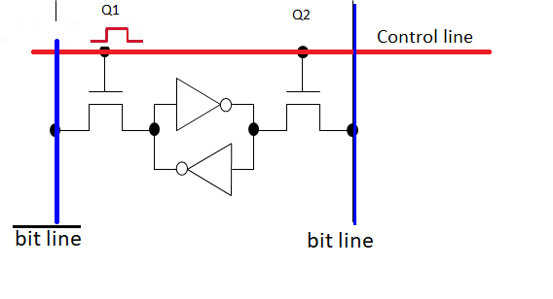
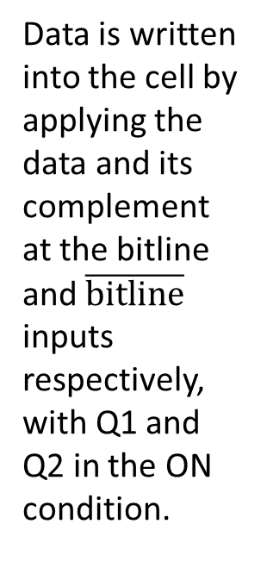
Static RAM (SRAM) Devices
• Static RAM memory devices retain data for as long as DC power is applied.
• Because no special action is required to retain data, these devices are called static memory.
Data is written into the cell by applying the data and its complement at the bitline and $\overline{bitline}$ inputs respectively, with Q1 and Q2 in the ON condition.
SRAM Cell

Slide 22
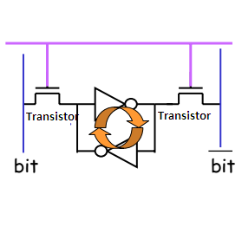
Static RAM (SRAM) Devices
• Static RAM memory devices retain data for as long as DC power is applied.
• Because no special action is required to retain data, these devices are called static memory.
SRAM Cell

Slide 23
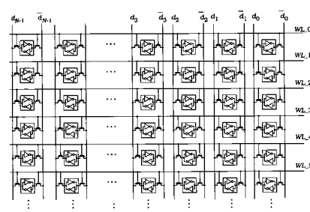

Slide 24
DRAM Memory
Inside a dynamic RAM chip, each memory cell holds one bit of information and is made up of two parts: a transistor and a capacitor.
The capacitor holds the bit of information -- a 0 or a 1. The transistor acts as a switch that lets the control circuitry on the memory chip read the capacitor or change its state.
For dynamic memory to work, either the CPU or the memory controller has to come along and recharge all of the capacitors holding a 1 before they discharge. To do this, the memory controller reads the memory and then writes it right back. This refresh operation happens automatically thousands of times per second.

Slide 25
DRAM & SRAM Memory
This refresh operation is where dynamic RAM gets its name. Dynamic RAM has to be dynamically refreshed all of the time or it forgets what it is holding. The downside of all of this refreshing is that it takes time and slows down the memory.
Static RAM uses a completely different technology. In static RAM, a form of flip-flop holds each bit of memory. A flip-flop for a memory cell takes 4 or 6 transistors along with some wiring, but never has to be refreshed. This makes static RAM significantly faster than dynamic RAM. However, because it has more parts, a static memory cell takes a lot more space on a chip than a dynamic memory cell. Therefore it holds less memory per chip, and that makes static RAM a lot more expensive.

Slide 26
DRAM & SRAM Memory
Static RAM is fast and expensive, and dynamic RAM is less expensive and slower. Therefore static RAM is used to create the CPU's speed-sensitive cache memory, while dynamic RAM forms the larger system RAM space.

Slide 27
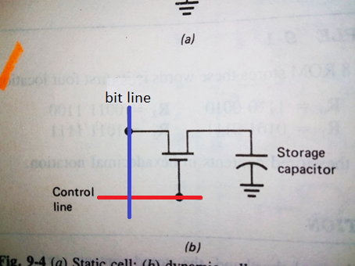
Dynamic RAM (DRAM) Memory
DRAM is essentially the same as SRAM, except that it retains data for only 2 or 4 ms on an integrated capacitor.
After 2 or 4 ms, the contents of the DRAM must be completely rewritten (refreshed) because the capacitors, which store a logic 1 or logic 0, lose their charges.
DRAM Cell

Slide 28
Difference between SRAM VS DRAM
SRAM | DRAM
SRAM uses flipflops. | DRAM uses capacitors.
Stores data till power is supplied. | Stores data only for few seconds even when power is supplied.
Does not refresh the memory cell. | Continuous refreshing is required to retain data.
Data access is faster. | Data access is slower.
Consume less power. | Consume more power.
Less memory per chip because bit density is low compared to DRAM. Therefore, Cost per bit is high. | More memory per chip. Since only a single transistor and a capacitor are employed to store a bit. Therefore, Cost per bit is low.

Slide 29
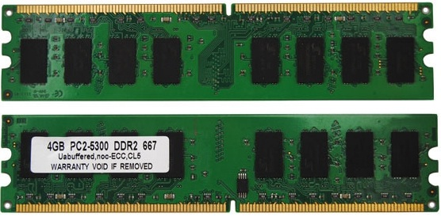
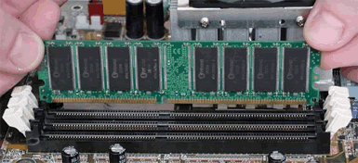

Slide 30
Memory Decoding
In general, all the memory locations are not implemented.
All the address are not used by the memory devices to select particular memory locations.
The unused lines are used to decode to generate chip select signals.
Basically, two techniques are used to decode the address
Linear or Partial decoding
Absolute or Full decoding

Slide 31
Memory Decoding
Linear decoding/Partial Decoding
All the address lines are not used to generate chip select, basically used in small systems
Individual high order address lines are used to decode the chip select for the memory chips using less hardware
Disadvantages: Each memory location has more than one address called memory foldback.
Check Rafiquzzaman book

Slide 32
Memory Decoding
Draw the diagram of 8-bit microprocessor with 16 bit address bus and 8 bit data bus interfaced with 6KB RAM using linear decoding method. Each RAM chip has 10 bit address bus and 8 bit data bus. Also provide the corresponding address map (starting address and end address) for each RAM chip

Slide 33
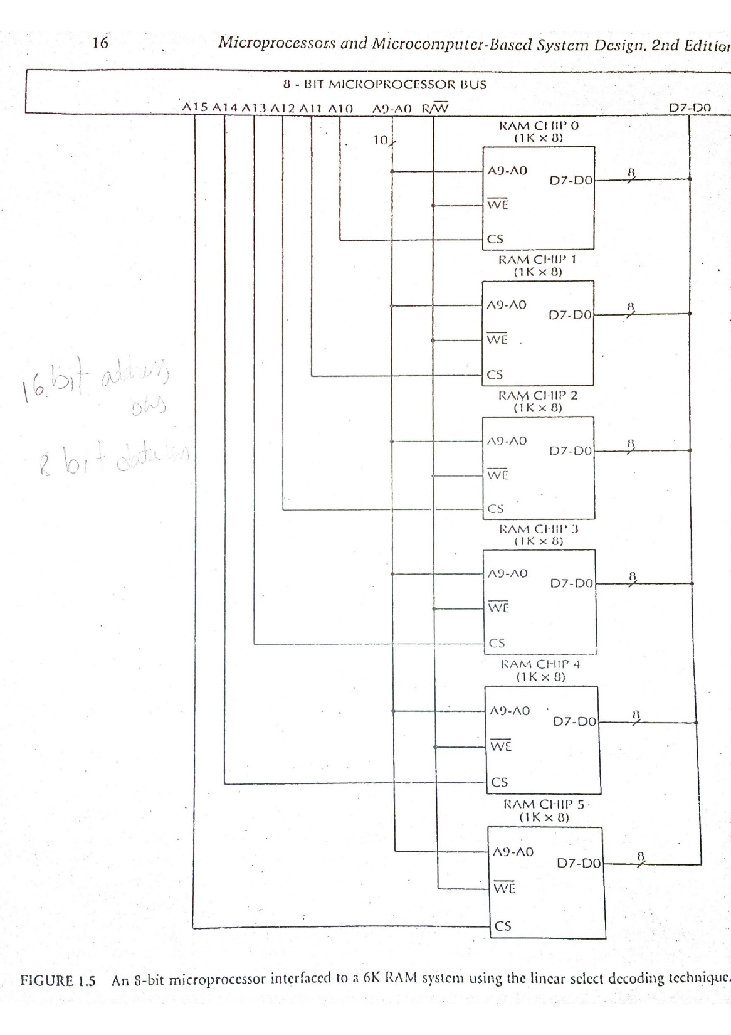

Slide 34
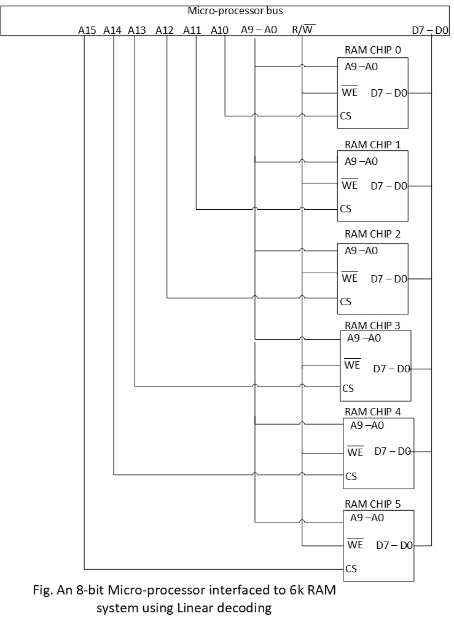

Slide 35
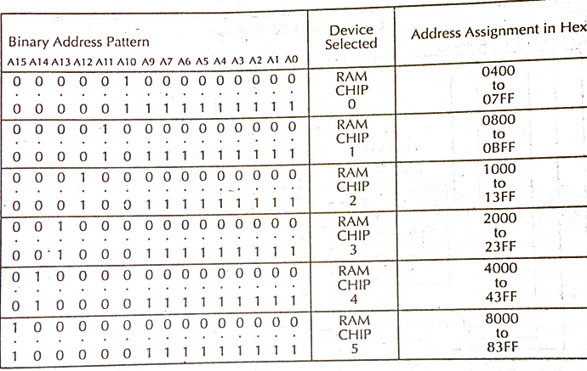
Address map

Slide 36
Drawback
For 8-bit microprocessor with 16 bit address bus and 8 bit data bus, we have 64KB of RAM memory space. However, we can interface with 6KB of RAM memory space where each RAM chip has 10 bit address bus and 8 bit data bus. This means that this idea wastes address space.
The address map is not contiguous, rather, it is sparsely distributed.
Address line A10 and A11 connected with RAM chip select (CS) of RAM chip 0 and 1. If both A10 and A11 are high at the same time then a bus conflict occurs. This can be avoided by proper programming to select desired memory chip.

Slide 37
Drawback
If all unused address lines are not utilized as chip select then total memory size is reduced. It is called memory foldback and it wastes memory space. For example, if A15 is don’t care in design then memory size is reduced from 6KB to 5 KB.

Slide 38
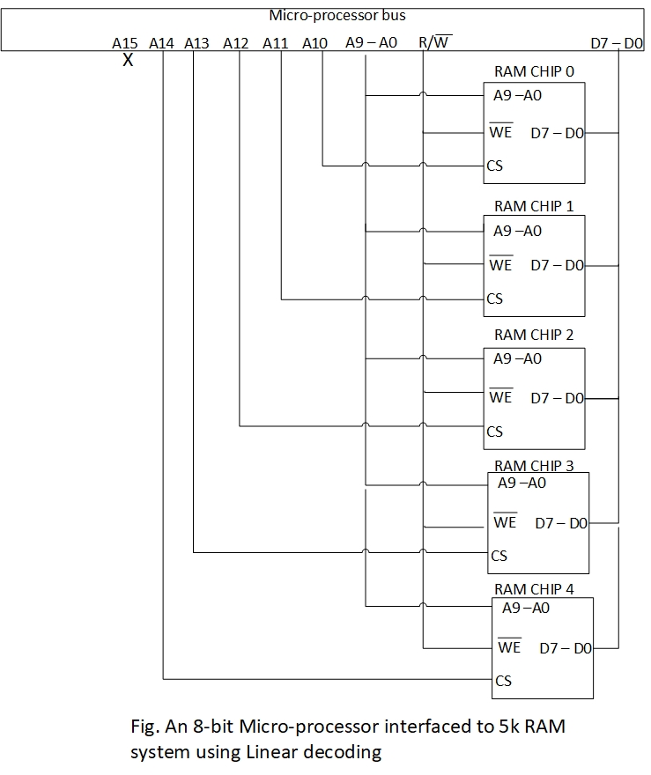

Slide 39
Memory Decoding
Full Decoding
All of the higher address lines are decoded to select memory chip, and the chip is selected only for the specified logic levels on these high order address lines.
Each memory location has unique address
Disadvantages: it needs more hardware for decoding

Slide 40
Memory Decoding
Full Decoding
Draw the diagram of an 8-bit microprocessor with 16 bit address bus and 8 bit data bus interfaced to 4KB RAM system using the full decoding method. Each RAM chip has 10 bit address bus and 8 bit data bus. Provide the corresponding address map (starting address and end address) for each RAM chip.

Slide 41
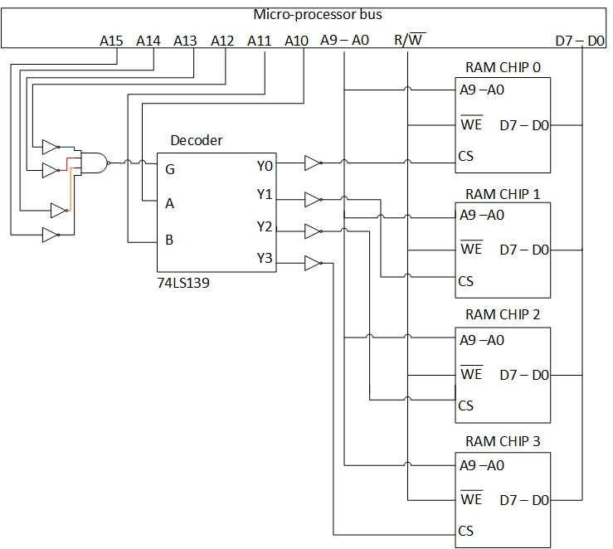
Figure: 8 bit microprocessor interfacing with 4KB RAM chip using full decoding technique

Slide 42
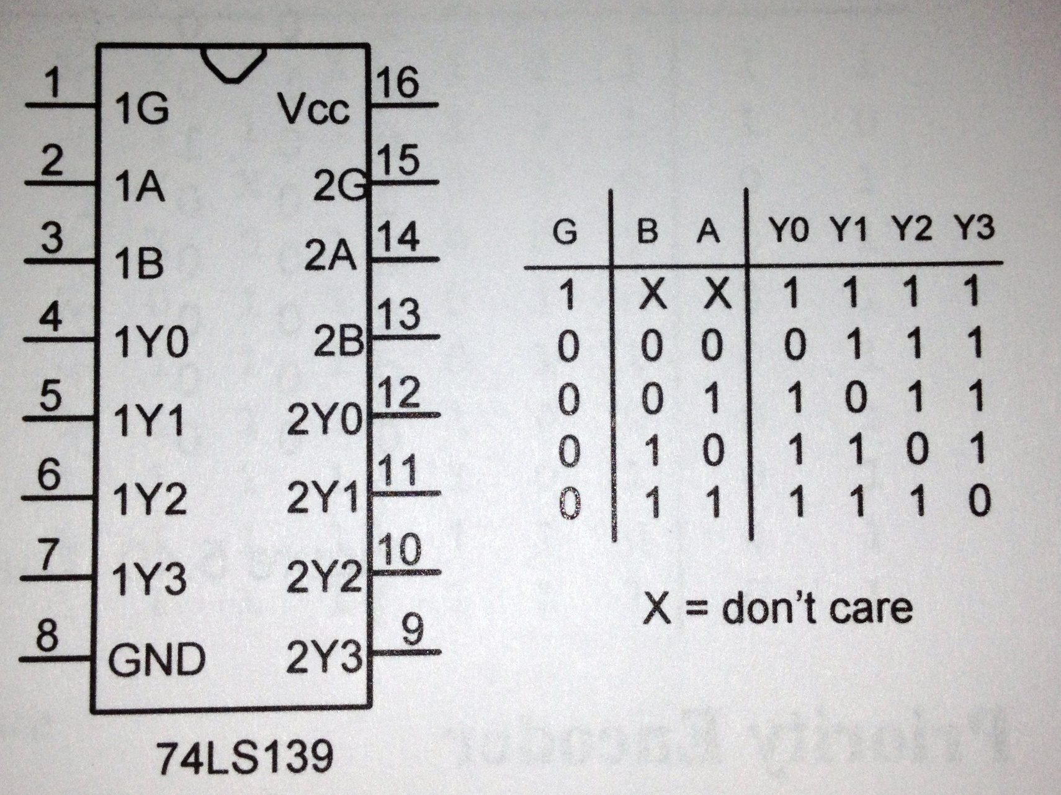
Truth table for 74LS39

Slide 43
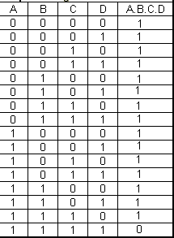
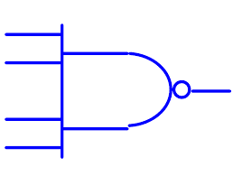
Truth table for NAND gate

Slide 44
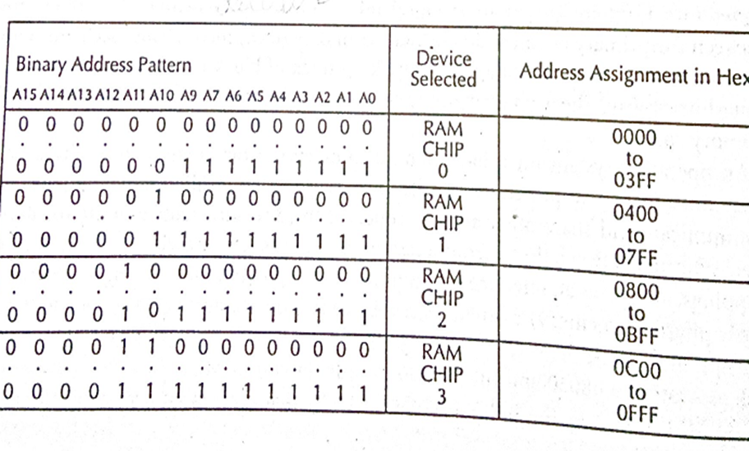
Address map

Slide 45
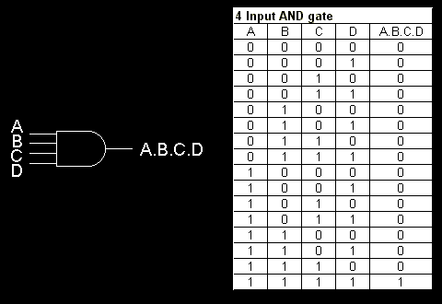
Truth table for AND gate

Slide 46
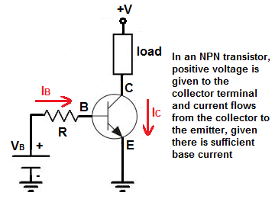
Reference

Slide 47
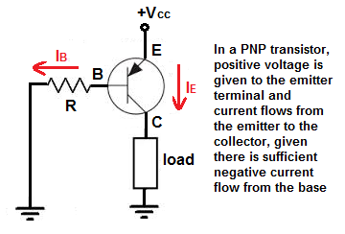
Reference

Slide 48
Thank You

